Slide 1
TRANSDUCERS

Slide 2
Introduction
A transducer is a device that converts energy from one form to another.
Energy forms can be mechanical, visual, aural, electrical, thermal, chemical, etc. (examples to follow).
Used to change information into a form that can be easily transferred, stored, processed, interpreted, etc.

Slide 3
Types of Energy Transformations
Electromagnetic - EM fields current
Examples:
Receiving Antennas Transmitting Antennas

Slide 4
Electroacoustic - vibration voltage
Examples:
Loudspeaker Microphone

Slide 5
Photoelectric - light voltage
Examples:
Light Bulb Photodiode

Slide 6
Thermoelectric – temperature voltage
Examples:
Hotplate Thermistor

Slide 7
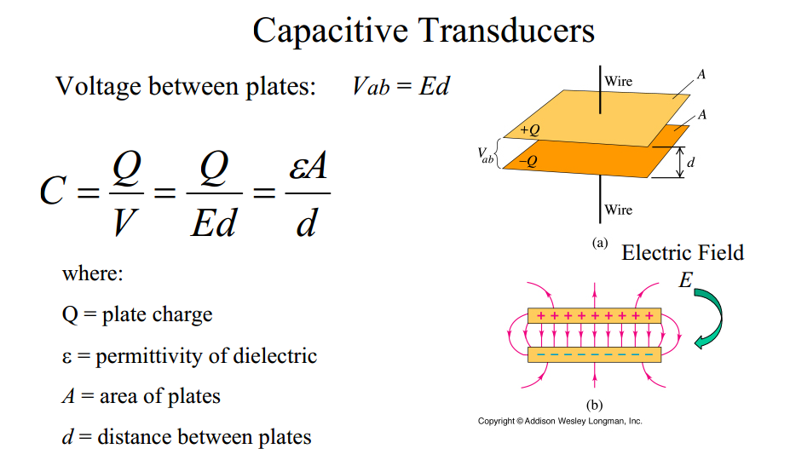
Principles of Energy Transformation
Capacitive Transducers

Slide 8
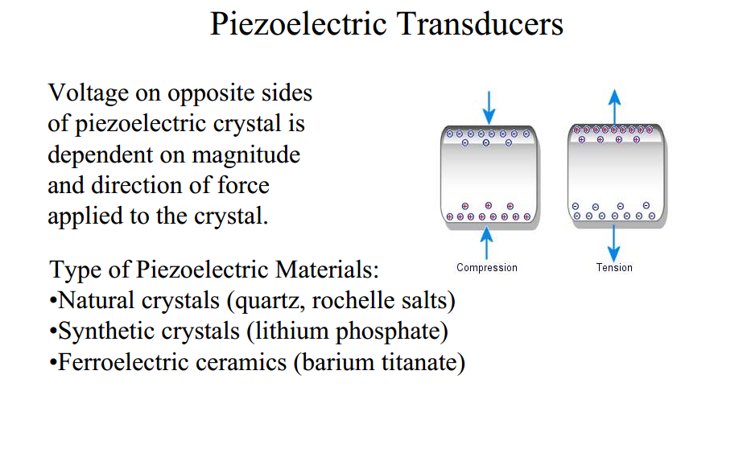

Slide 9
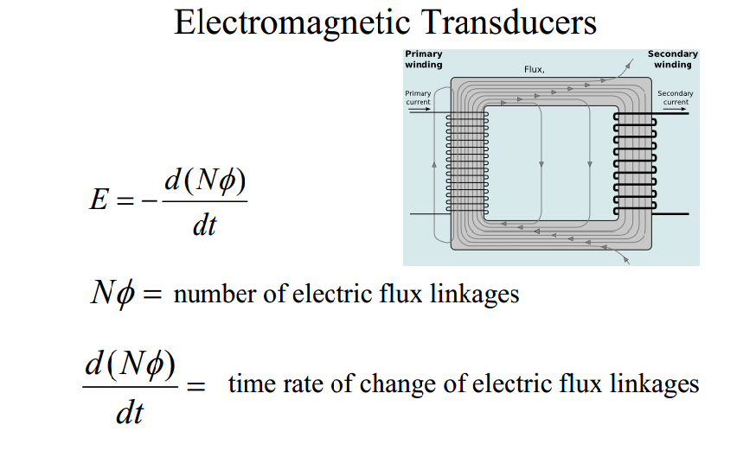

Slide 10
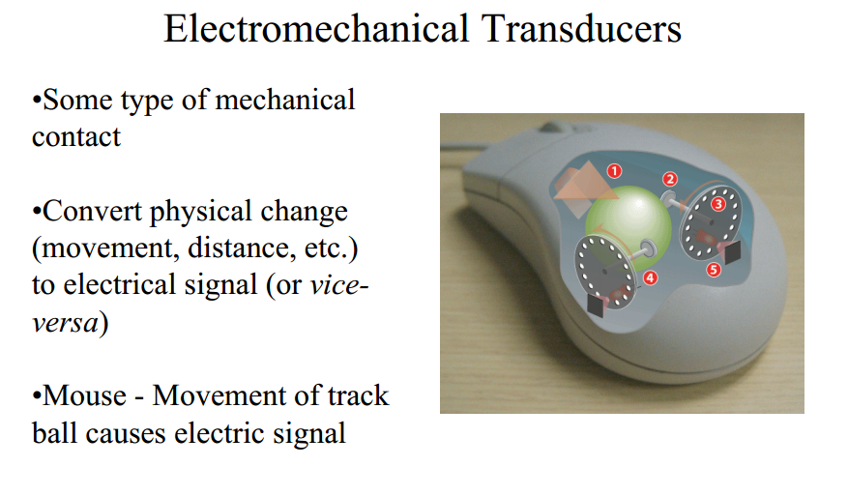

Slide 11
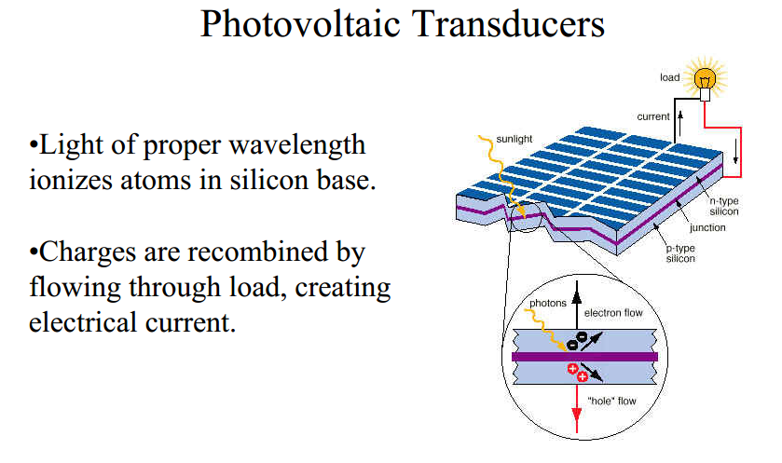

Slide 12
Terminology
Measurand - that property being quantified or transformed.
•Passive Transducer (Sensor) - one which draws its
operating power from the measurand.
•Active Transducer - one which requires external power.
•Accuracy - how close is the measurement to the actual value?
•Resolution - how fine of a measurement can we make?
•Range - what input (and output) values are possible?

Slide 13
Sensitivity - how much does a change in input affect
the output? (also called the scale factor.)
•Linearity - does the output change uniformly with the
input?
•Repeatability - output signal should be the same whenever
the measurand value is the same.
•Response Time - how quickly does the transducer respond
to changes in the measurand value?

Slide 14
Packaging and Integration
Considerations:
•Technology
•Environment
•End User
•Cost

Slide 15
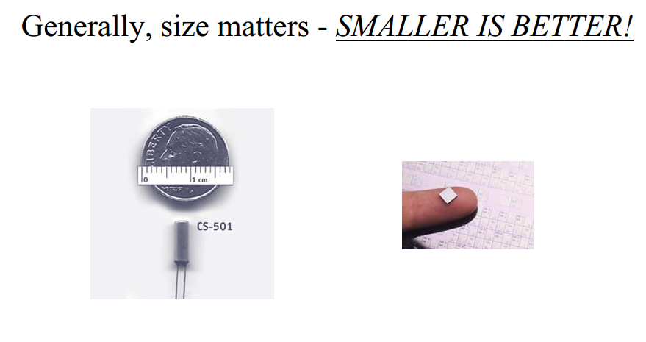

Slide 16
Summary
A transducer converts energy from one form to another
A passive transducer is called a sensor
Transducer form is often influenced by function (and vice-versa)
Trend is to have sensor package as small as possible

